Slide 1
Getting Started With SU²
Code Installation, RANS Analysis, and Shape Design
July 1st, 2014
Francisco Palacios, Michael Colonno,
Thomas D. Economon, Juan J. Alonso
Department of Aeronautics & Astronautics
Stanford University

Slide 2

Getting Started
Building SU²
ANALYSIS Example:
Onera m6 wing
DESIGN EXAMPLE:
ONERA M6 Wing

Slide 3
Getting Started
Building SU²
ANALYSIS Example:
Onera m6 wing
DESIGN EXAMPLE:
ONERA M6 Wing

Slide 4
Getting Started Downloading the Code
Check out the download portal on the main website: http://su2.stanford.edu/download.html.
If that site is blocked, download the V3.2 version (zip) directly from GitHub here: https://github.com/su2code/SU2/releases.
Register and download binaries or source for major releases there.
Developer versions of the code are also available on GitHub: http://github.com/su2code.html.
Suite of test cases also available (includes tutorial files).
SU2 V3.2 was recently released at AIAA AVIATION on June 17, 2014
Recommended: Register and download the source code and test cases for SU2 V3.2 or get the latest and greatest from GitHub

Slide 5
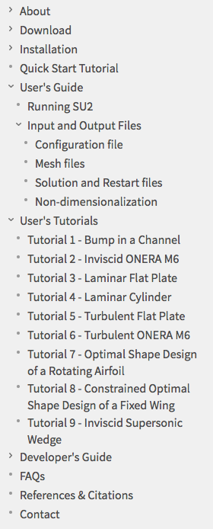
Getting Started Documentation and Tutorials
A large body of documentation is available!
Main documentation found under “Guides” linked on the main page:
http://adl-public.stanford.edu/docs/display/SUSQUARED/SU2+Home
Detailed information on installation, input and output files, etc.
Contains step-by-step tutorials
Wiki-style docs that the developers maintain
See current contents to the right…

Slide 6
Getting Started Documentation and Tutorials
Additional training materials: http://su2.stanford.edu/training.html.
Links to tutorials, presentations, files, and videos
Active forum on CFD Online: http://www.cfd-online.com/Forums/su2/.
Recent AIAA publications with some technical detail on physics, numerical methods, and V&V:
Stanford University Unstructured (SU2): An open-source integrated computational environment for multi-physics simulation and design, AIAA Paper 2013-0287
Stanford University Unstructured (SU2): Open-source analysis and design technology for turbulent flows, AIAA Paper 2014-0243
Tip: If you get stuck or have questions, just drop us a line at our personal emails or susquared-dev@lists.stanford.edu

Slide 7
Getting Started
Building SU²
ANALYSIS Example:
Onera m6 wing
DESIGN EXAMPLE:
ONERA M6 Wing

Slide 8
Building SU² Our Open-Source Build Philosophy
As an open-source code, care has been taken to simplify the build process wherever possible:
Use standard C++
Leverage standard build tools, i.e., autoconf and automake
Avoid or automatically include external dependencies
To build the vanilla version, all you should need is a C++ compiler.
However, we maintain the flexibility to build with additional features:
Fully parallel with MPI, specify your MPI flavor with configure
METIS ships with SU2 and is automatically built for parallel runs
Tecio for binary Tecplot output also ships as an optional feature
CGNS mesh input capability (unstructured, single block)

Slide 9
Building SU² Customizing and Compiling from Source
Download and untar the code, then move into the source directory. $ tar -xzf SU2v3.2.0.tgz $ cd SU2
Specify various options, compilers, etc. and run configure. The following options are typical for high-performance/parallel operation. $ ./configure --with-MPI=mpicxx CXXFLAGS=‘-O3’ --prefix=/home/economon/SU2 --with-CGNS-lib=/home/economon/cgns-3.1.4/lib --with-CGNS-include=/home/economon/cgns-3.1.4/include
Make and install the code (location specified by the prefix option above). Note that this could be done in two separate steps, as “make” and “make install” consecutively at the command line. $ make -j 8 install
Update your PATH variables appropriately before executing. $ export SU2_RUN="/home/economon/SU2/bin” $ export SU2_HOME="/home/economon/SU2” $ export PATH=$SU2_RUN:$PATH $ export PYTHONPATH=$SU2_RUN:$PYTHONPATH

Slide 10
Building SU² Tips for Hassle-Free Builds
Recommended: CGNS V3.1.4 without HDF5
Tip: Use parallel make to accelerate the build, i.e., “$ make -j 24 install” to use 24 processes if you have a workstation with 24 cores.
Recommended: For advanced features in SU2, Python scripts are available. Try out the free Python distribution (V2.X distribution) with built-in packages by Enthought: https://www.enthought.com/products/epd/free/

Slide 11
Building SU² Tips for Hassle-Free Builds
$ alias config_serial="./configure CXXFLAGS='-O3' --prefix=/Users/economon/SU2 --enable-tecio”
$ alias config_mpi="./configure --with-MPI=mpicxx --prefix=/Users/economon/SU2 --enable-tecio CXXFLAGS='-O3’ --with-CGNS-lib=/usr/local/lib --with-CGNS-include=/usr/local/include”
Tip: Add an alias for your configure command and set the environment variables in your ~/.bashrc file (steps 2 and 4 on the previous slide).

Slide 12
Building SU² Tips for Hassle-Free Builds
$ export SU2_RUN="/home/economon/SU2/bin” $ export SU2_HOME="/home/economon/SU2” $ export PATH=$SU2_RUN:$PATH $ export PYTHONPATH=$SU2_RUN:$PYTHONPATH
Tip: Note the order of the PATH variable. $SU2_RUN appears before $PATH in this case. If $PATH comes before $SU2_RUN, make sure that there are not any previous versions of SU2 installed in other locations in your PATH, otherwise it may use old versions and cause headaches…

Slide 13
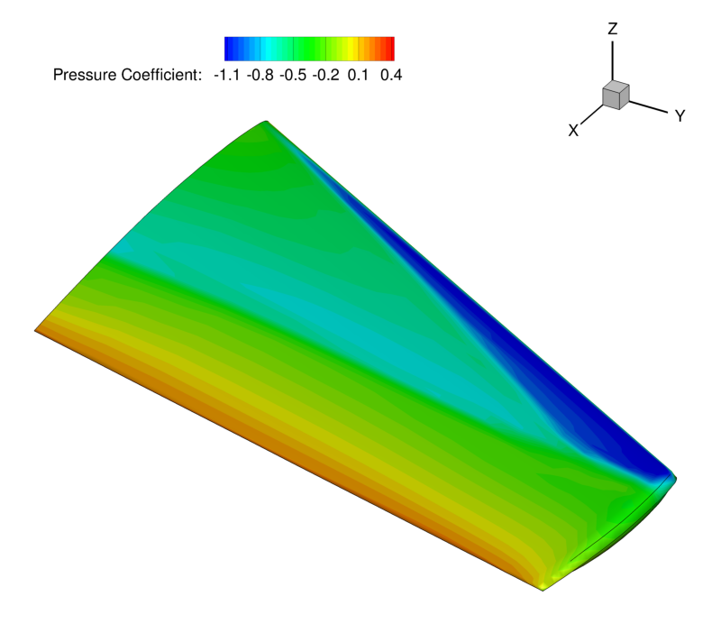
Getting Started
Building SU²
ANALYSIS Example:
Onera m6 wing
DESIGN EXAMPLE:
ONERA M6 Wing

Slide 14
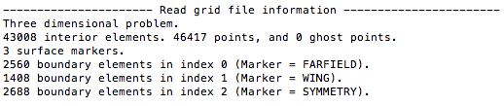
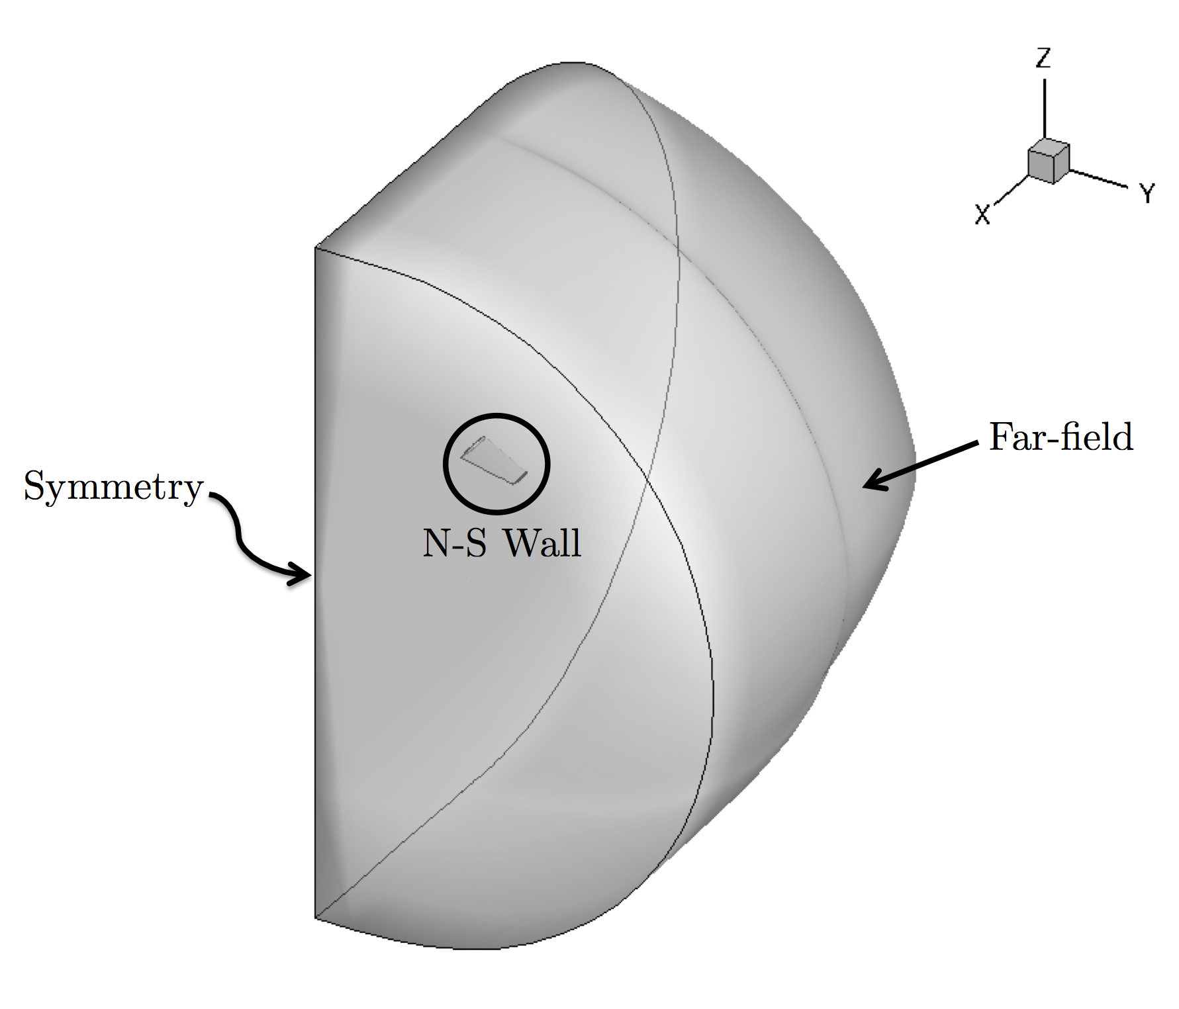
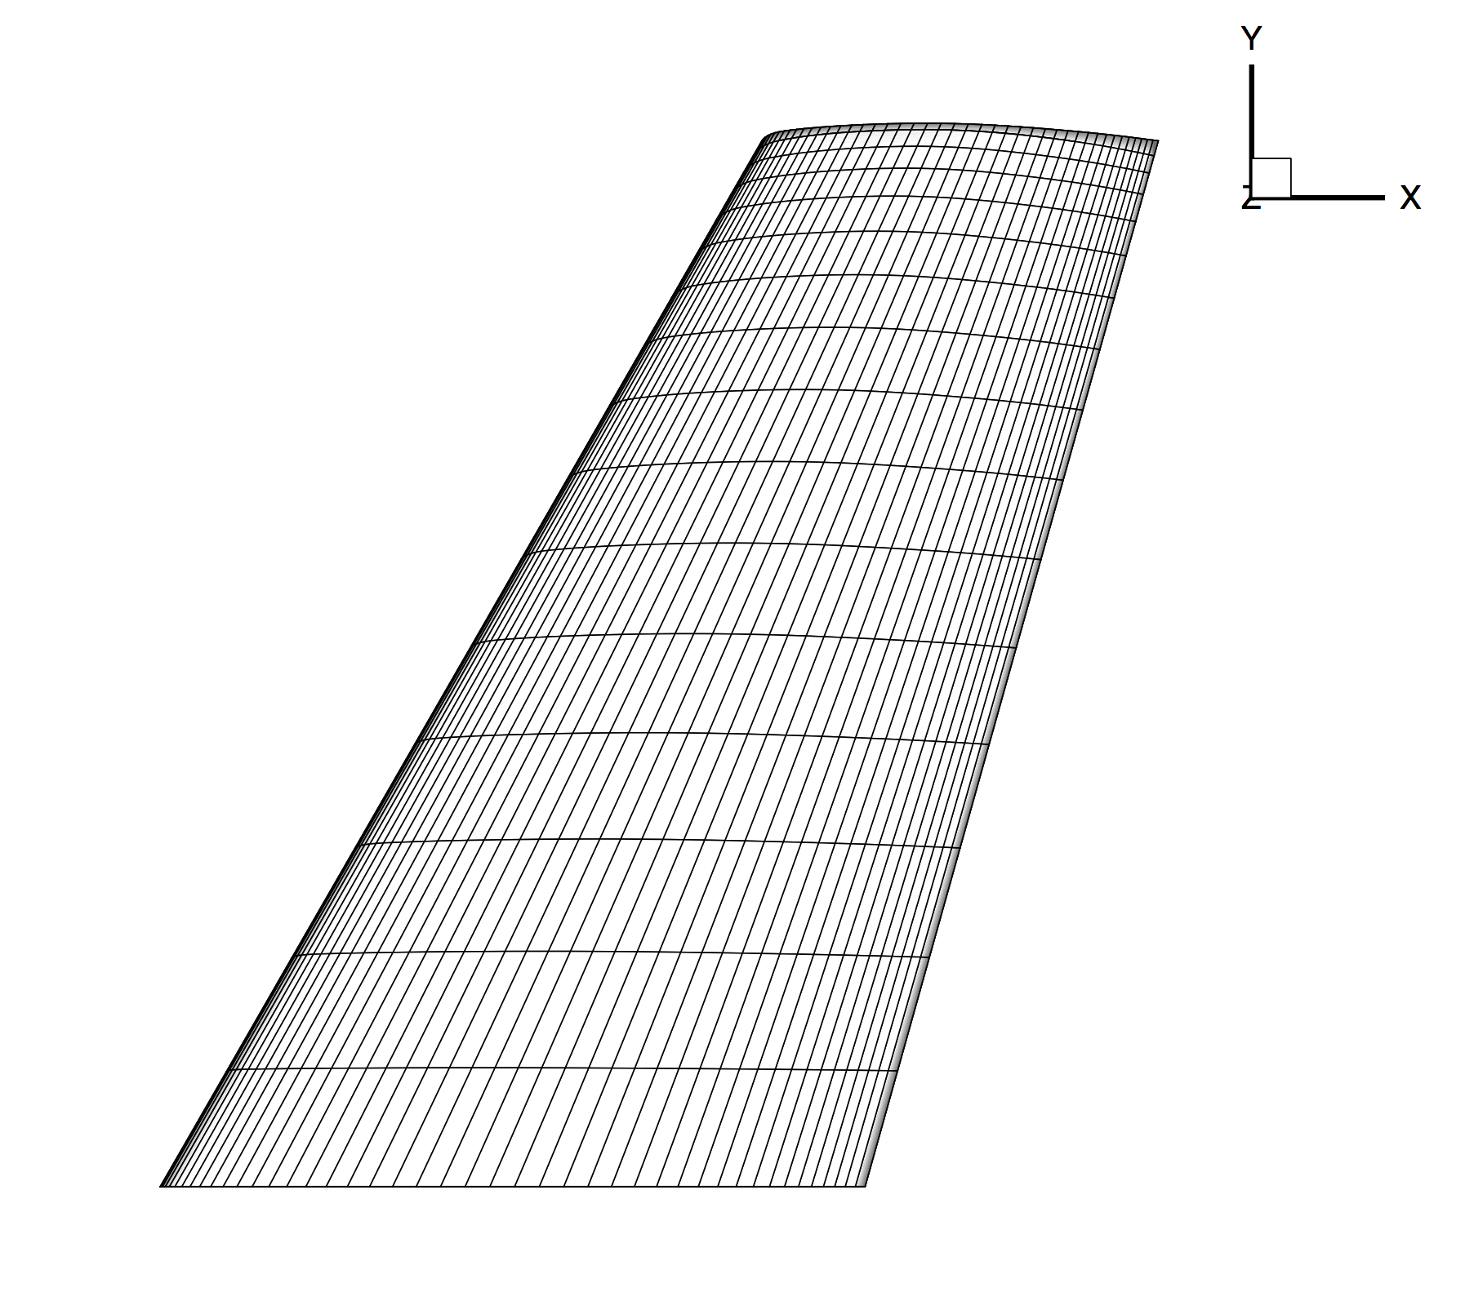
Optimal Shape Design
ONERA M6 RANS Analysis
Prepare geometry & mesh beforehand.
Choose appropriate physics.
Set proper conditions for a viscous simulation.
Select numerical methods:
Convective terms
Viscous terms
Time Integration
Multi-grid
Run the analysis.
Post-process the results.

Slide 15
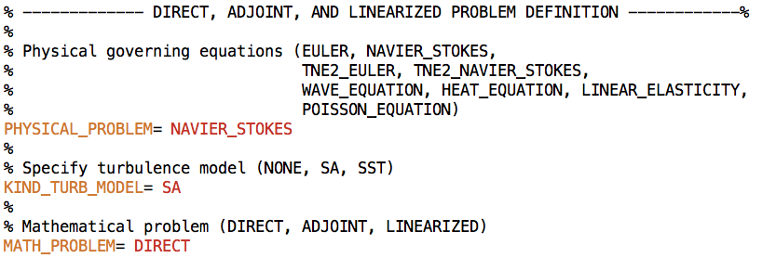
Optimal Shape Design
ONERA M6 RANS Analysis
Prepare geometry & mesh beforehand.
Choose appropriate physics.
Set proper conditions for a viscous simulation.
Select numerical methods:
Convective terms
Viscous terms
Time Integration
Multi-grid
Run the analysis.
Post-process the results.

Slide 16
ONERA M6 RANS Analysis
Prepare geometry & mesh beforehand.
Choose appropriate physics.
Set proper conditions for a viscous simulation.
Select numerical methods:
Convective terms
Viscous terms
Time Integration
Multi-grid
Run the analysis.
Post-process the results.
How are the flow conditions set inside SU2?
Store the gas constants and freestream temperature, then calculate the speed of sound.
Calculate and store the freestream velocity from the Mach number & AoA/sideslip angles.
Compute the freestream viscosity from Sutherland's law and the supplied freestream temperature.
Use the definition of the Reynolds number to find the freestream density from the supplied Reynolds information, freestream velocity, and freestream viscosity from step 3.
Calculate the freestream pressure using the perfect gas law with the freestream temperature, specific gas constant, and freestream density from step 4.
Perform any required non-dim.

Slide 17
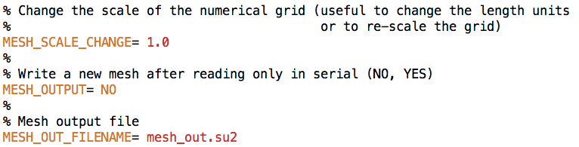
ONERA M6 RANS Analysis
Tip: Meshes should be in units of meters for viscous flows. Try the MESH_SCALE_CHANGE option in the configuration file.

Slide 18
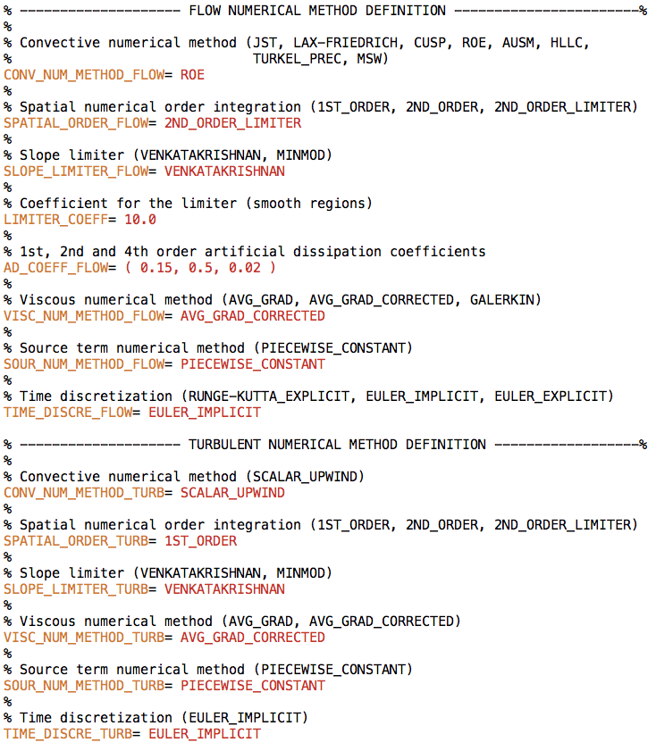
Optimal Shape Design
ONERA M6 RANS Analysis
Prepare geometry & mesh beforehand.
Choose appropriate physics.
Set proper conditions for a viscous simulation.
Select numerical methods:
Convective terms
Viscous terms
Time Integration
Multi-grid
Run the analysis.
Post-process the results.

Slide 19
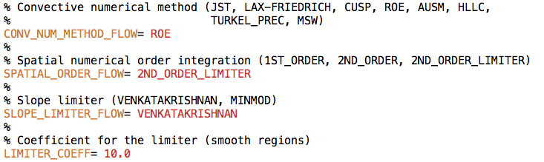
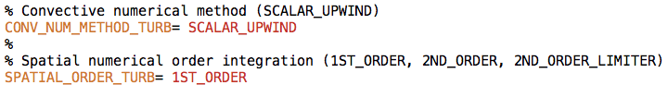
Optimal Shape Design
ONERA M6 RANS Analysis
Prepare geometry & mesh beforehand.
Choose appropriate physics.
Set proper conditions for a viscous simulation.
Select numerical methods:
Convective terms
Viscous terms
Time Integration
Multi-grid
Run the analysis.
Post-process the results.

Slide 20
Optimal Shape Design
ONERA M6 RANS Analysis
Prepare geometry & mesh beforehand.
Choose appropriate physics.
Set proper conditions for a viscous simulation.
Select numerical methods:
Convective terms
Viscous terms
Time Integration
Multi-grid
Run the analysis.
Post-process the results.

Slide 21
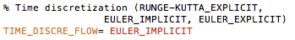
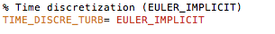
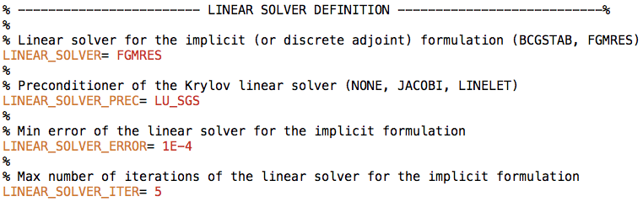
Optimal Shape Design
ONERA M6 RANS Analysis
Prepare geometry & mesh beforehand.
Choose appropriate physics.
Set proper conditions for a viscous simulation.
Select numerical methods:
Convective terms
Viscous terms
Time Integration
Multi-grid
Run the analysis.
Post-process the results.

Slide 22
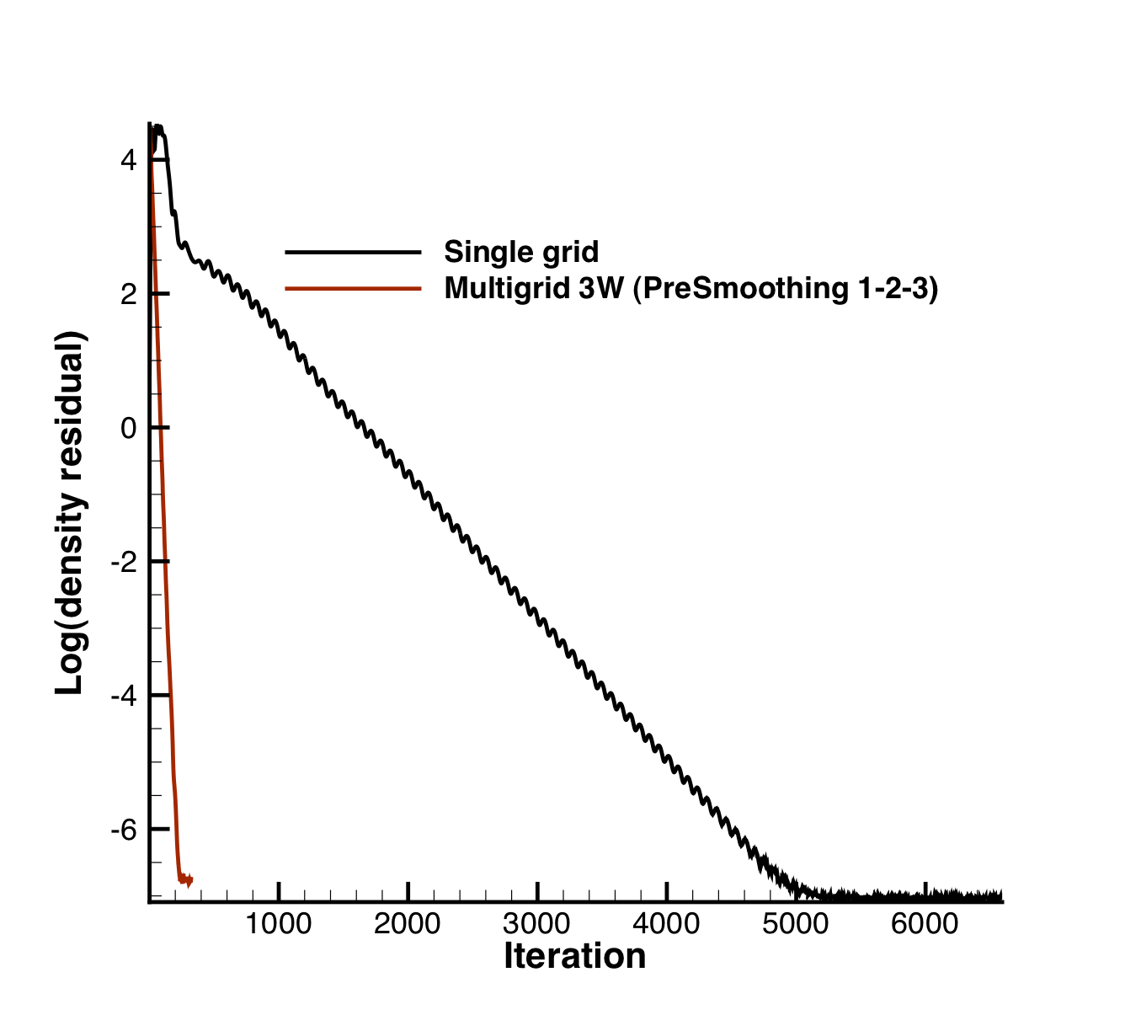
Optimal Shape Design
ONERA M6 RANS Analysis
Prepare geometry & mesh beforehand.
Choose appropriate physics.
Set proper conditions for a viscous simulation.
Select numerical methods:
Convective terms
Viscous terms
Time Integration
Multi-grid
Run the analysis.
Post-process the results.
Multigrid example with the inviscid ONERA M6

Slide 23
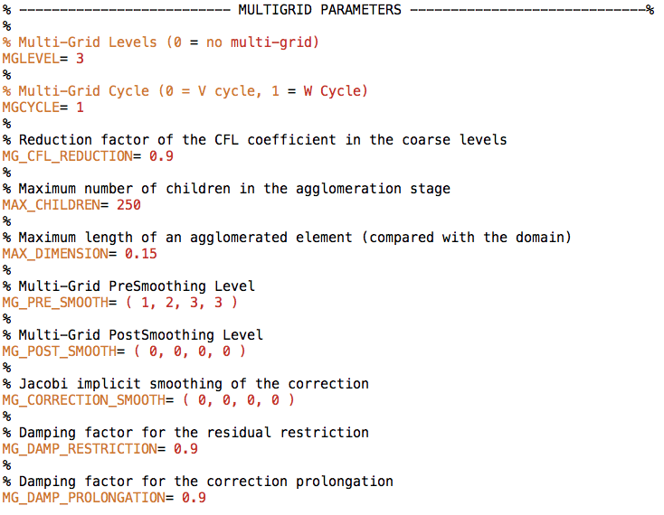
ONERA M6 RANS Analysis
Tip: There are many knobs available for tuning the agglomeration multigrid in the configuration file.

Slide 24
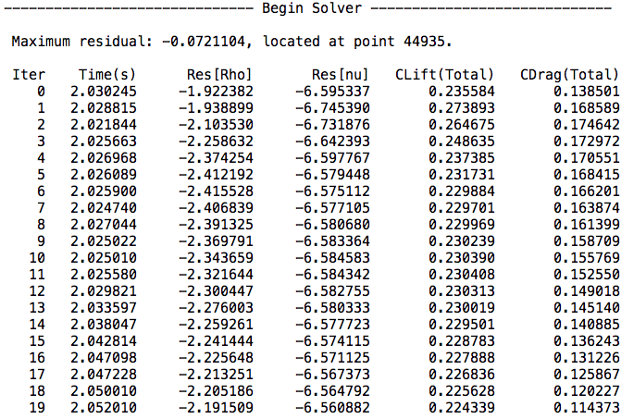
Optimal Shape Design
ONERA M6 RANS Analysis
Prepare geometry & mesh beforehand.
Choose appropriate physics.
Set proper conditions for a viscous simulation.
Select numerical methods:
Convective terms
Viscous terms
Time Integration
Multi-grid
Run the analysis.
Post-process the results.
The files for this case can be found in TestCases/rans/oneram6/. Run the case with:
$ SU2_CFD turb_ONERAM6.cfg

Slide 25
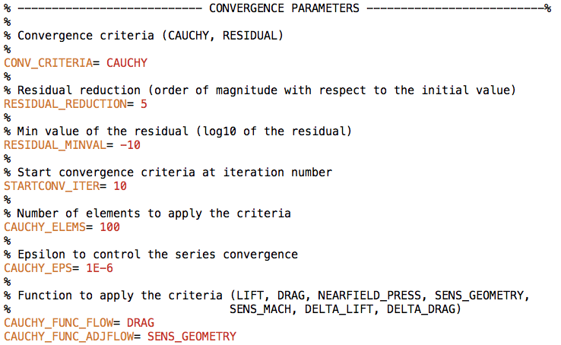
ONERA M6 RANS Analysis
Tip: Convergence can be controlled based on the residual (RESIDUAL) or by monitoring coefficients (CAUCHY).

Slide 26
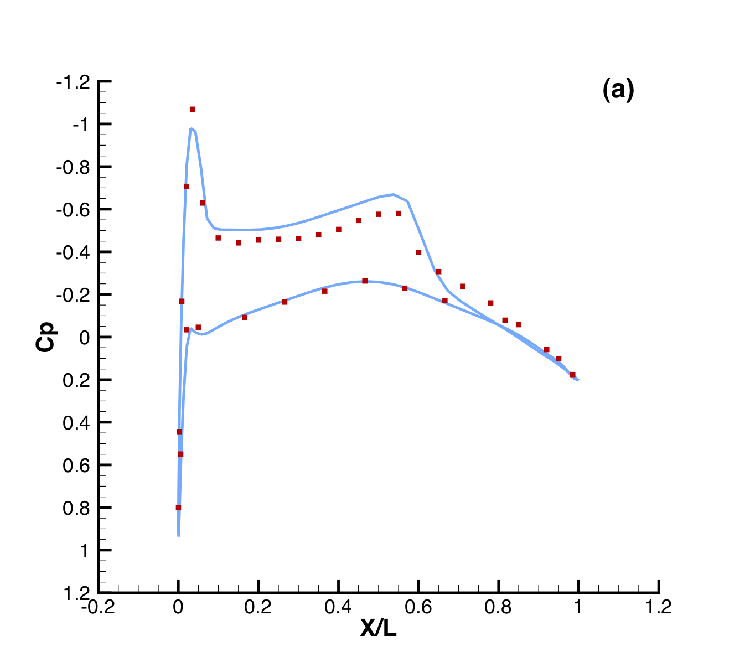
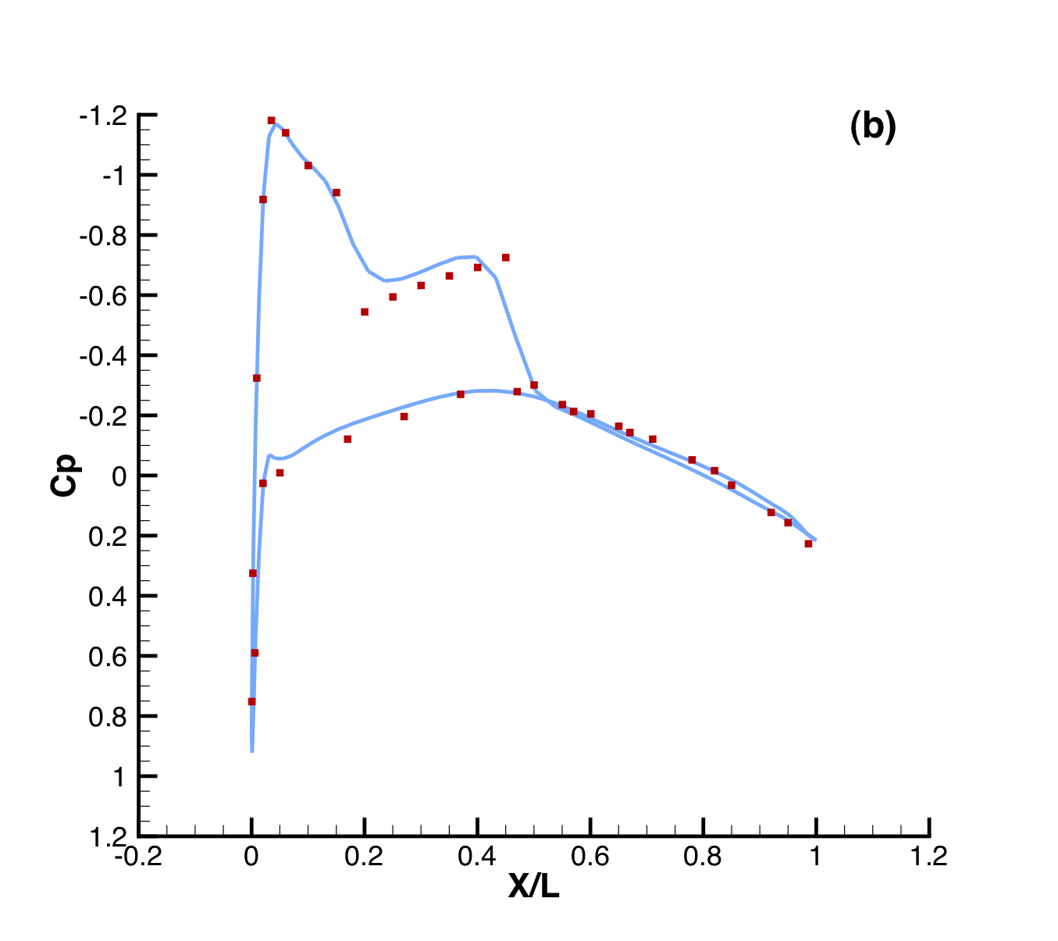
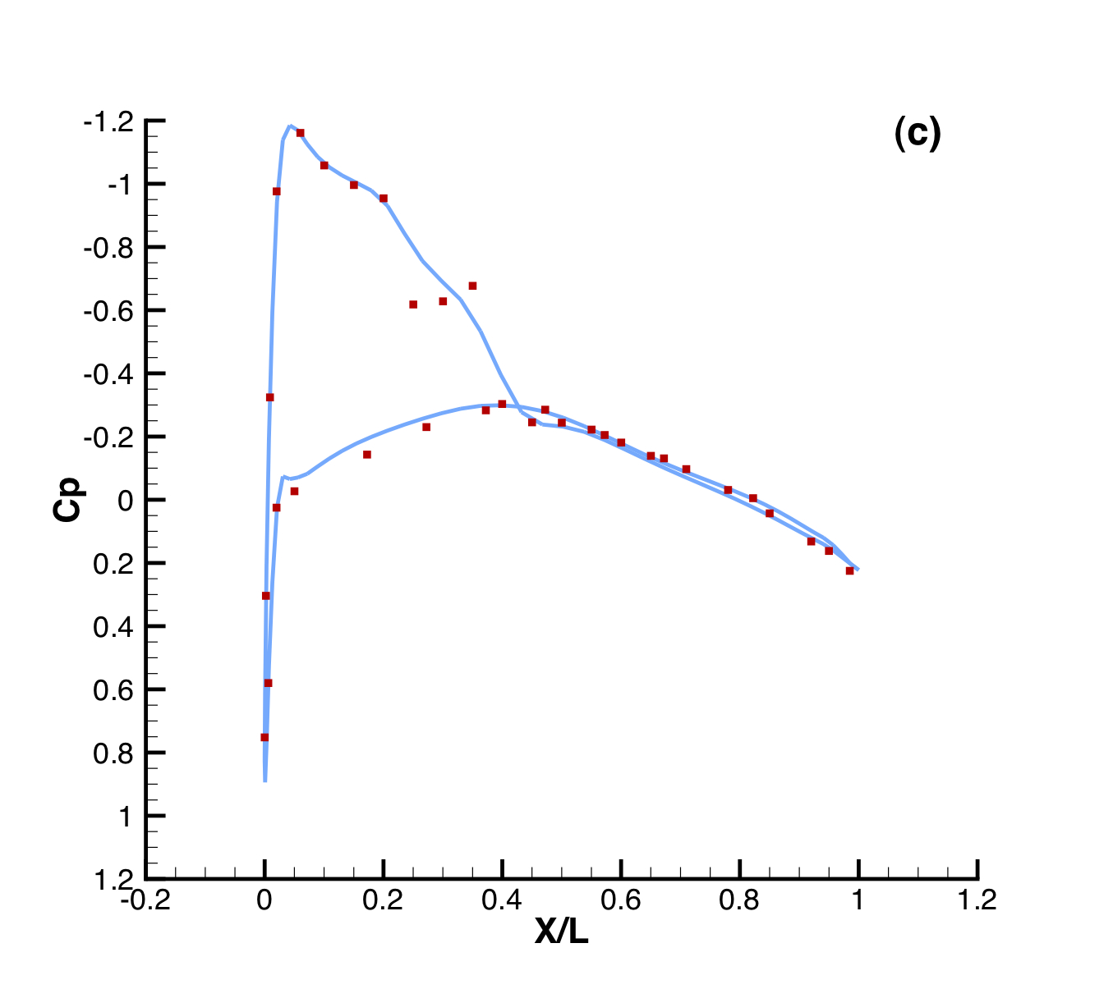
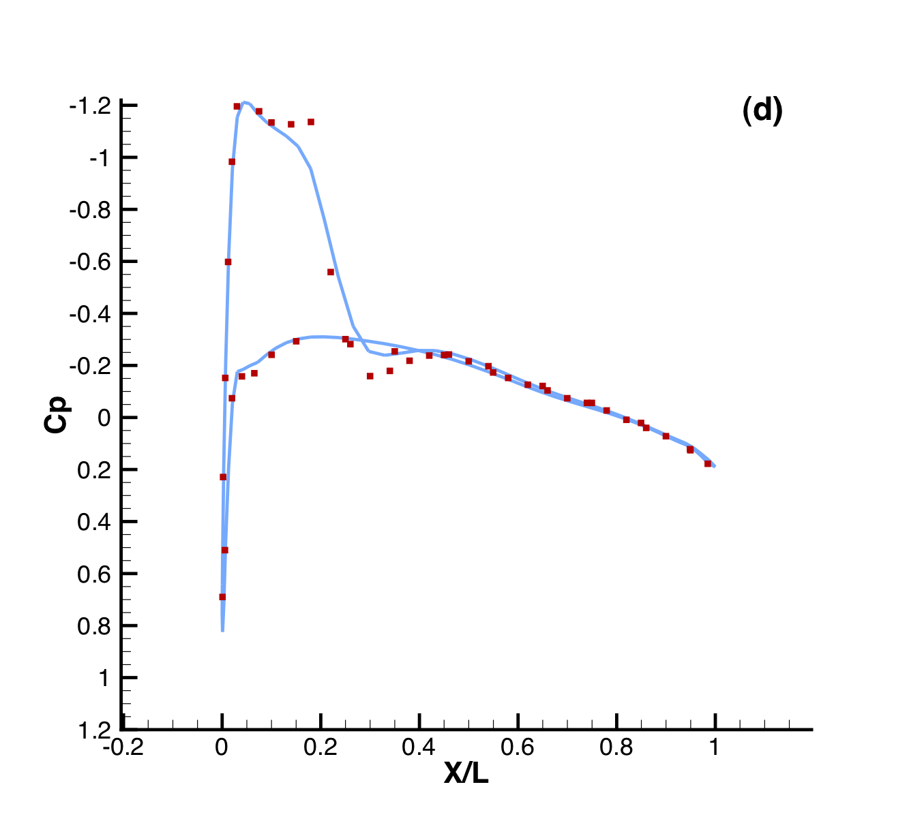
Optimal Shape Design
ONERA M6 RANS Analysis
Prepare geometry & mesh beforehand.
Choose appropriate physics.
Set proper conditions for a viscous simulation.
Select numerical methods:
Convective terms
Viscous terms
Time Integration
Multi-grid
Run the analysis.
Post-process the results.
Comparison of Cp profiles of the experimental results of Schmitt and Carpin (red squares) against SU2 computational results (blue line) at different sections along the span of the wing. (a) y/b = 0.2, (b) y/b = 0.65, (c) y/b = 0.8, (d) y/b = 0.95

Slide 27
Optimal Shape Design
ONERA M6 RANS Analysis
Tip: Tecplot ASCII is the default output, but ParaView and binary formats are available

Slide 28
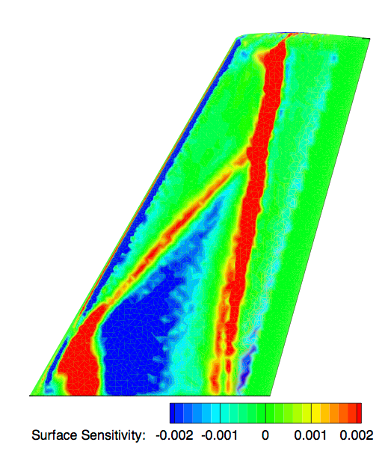
Getting Started
Building SU²
ANALYSIS Example:
Onera m6 wing
DESIGN EXAMPLE:
ONERA M6 Wing

Slide 29
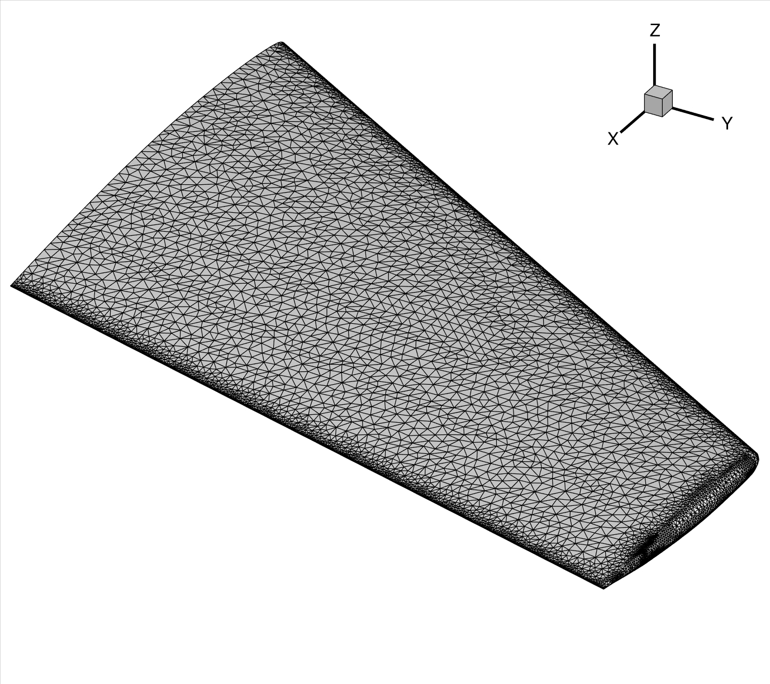
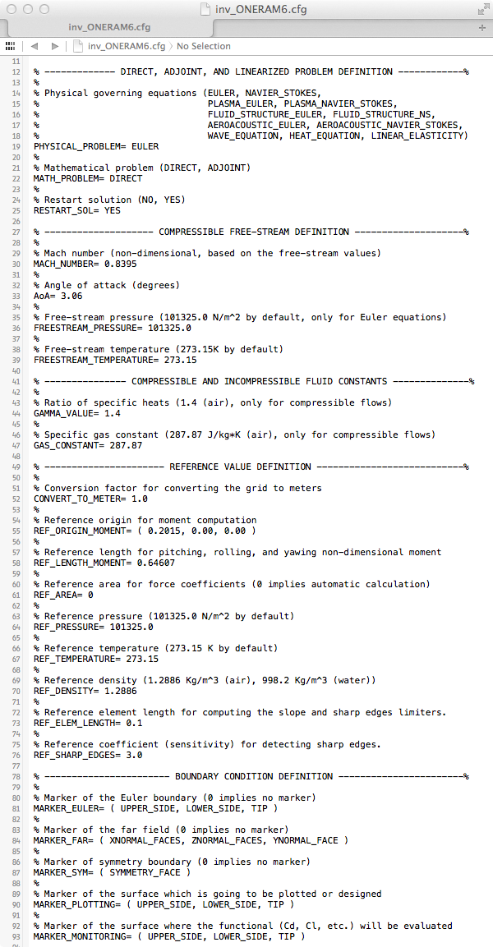
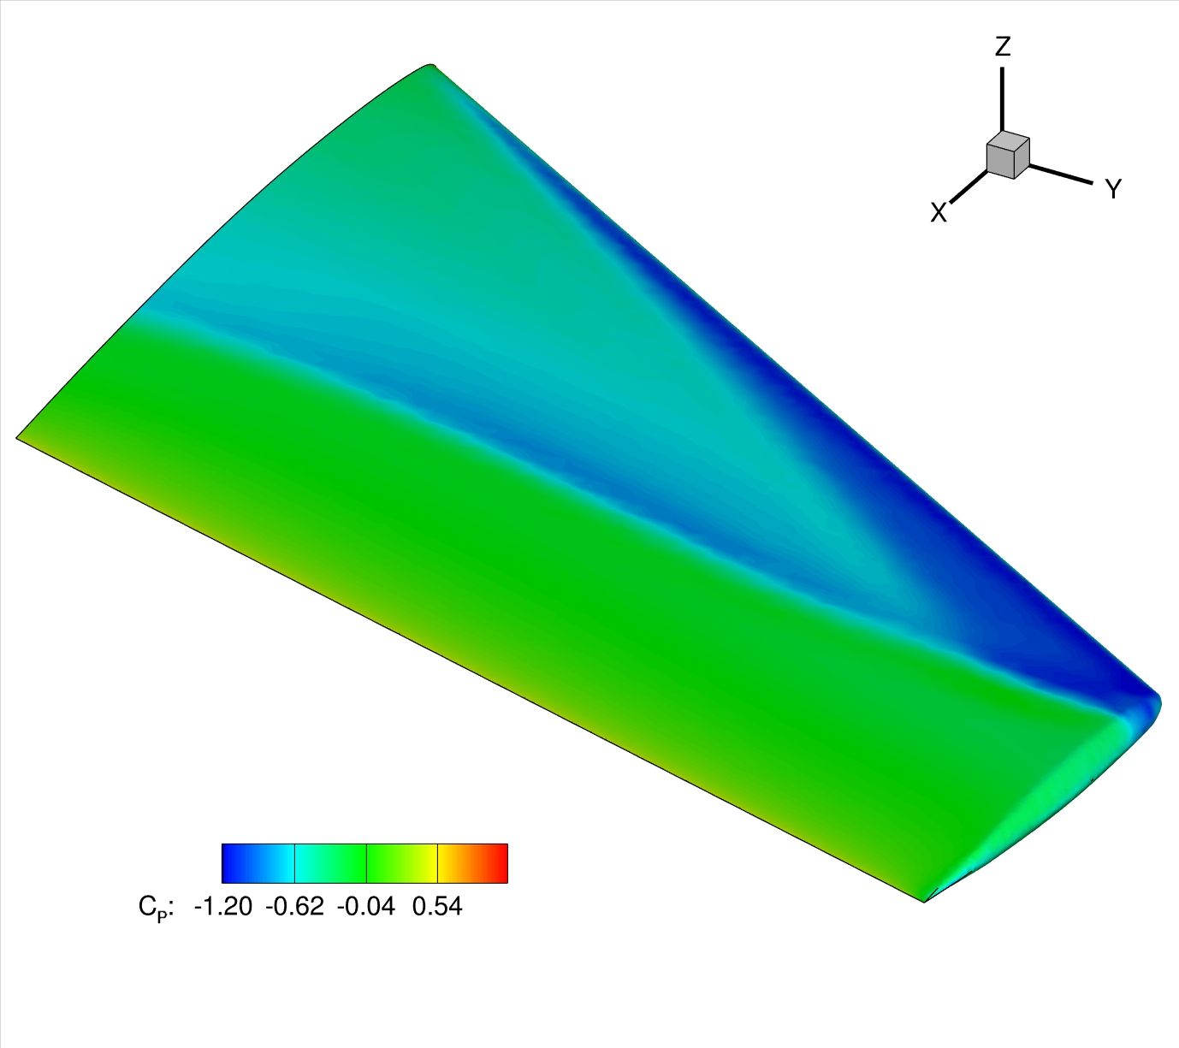
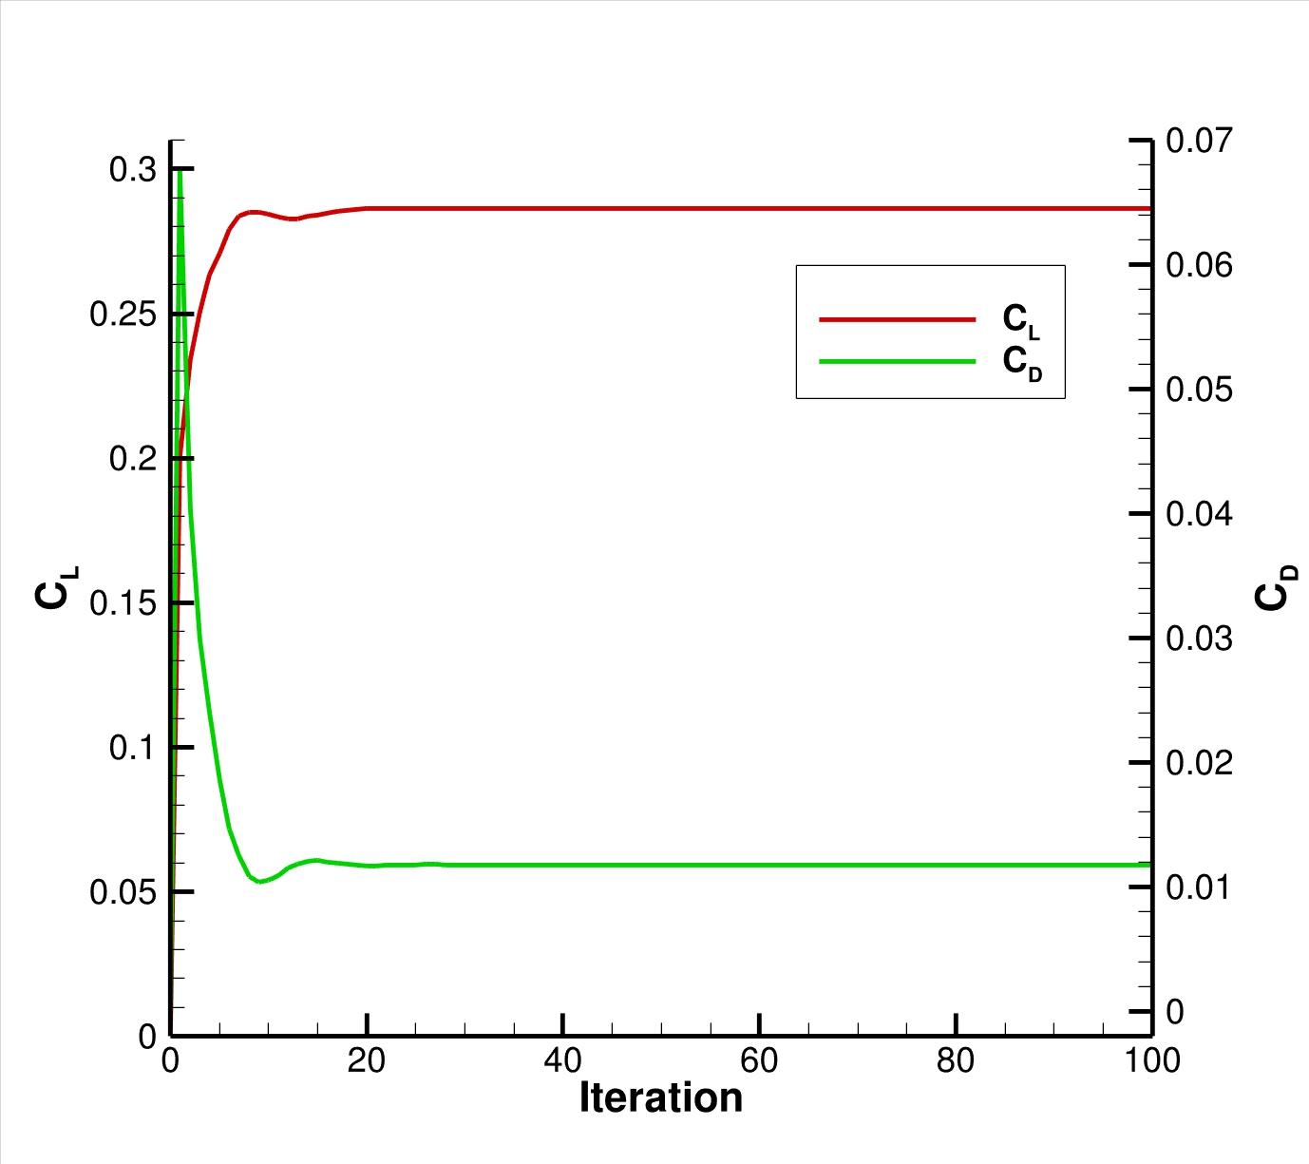
ONERA M6 Shape Optimization (Euler and RANS)
Define and run the physical problem.
Evaluate geometry (thickness, AoA, etc).
Define 3D design variables.
Create the FFD box (.su2 file).
FFD design variables preprocessing.
Define the optimization problem
Objective function.
Constraints (flow and geometry).
Design variables based on FFD box.
Checks before the optimization (optional).
Compute C_{D}, and C_{L} gradients.
Compute geometric gradients.
Final checks (optional).
Restart files are available.
The grid contains the FFD information.
The stop criteria is reasonable.
The proposed optimization problem makes sense (scaling).
Run the optimization.
Analyze the solution.
Folder structure and history_project file.
Restart capability.

Slide 30
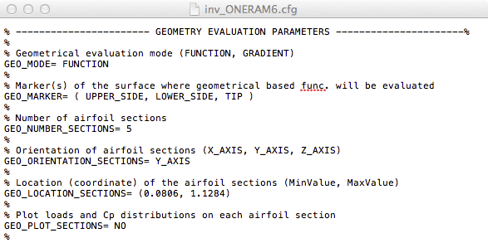
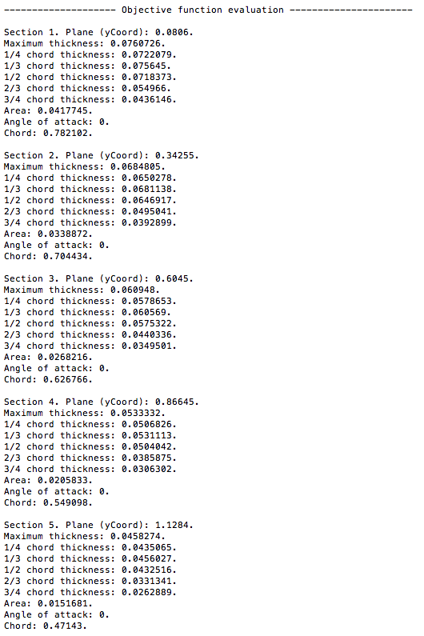
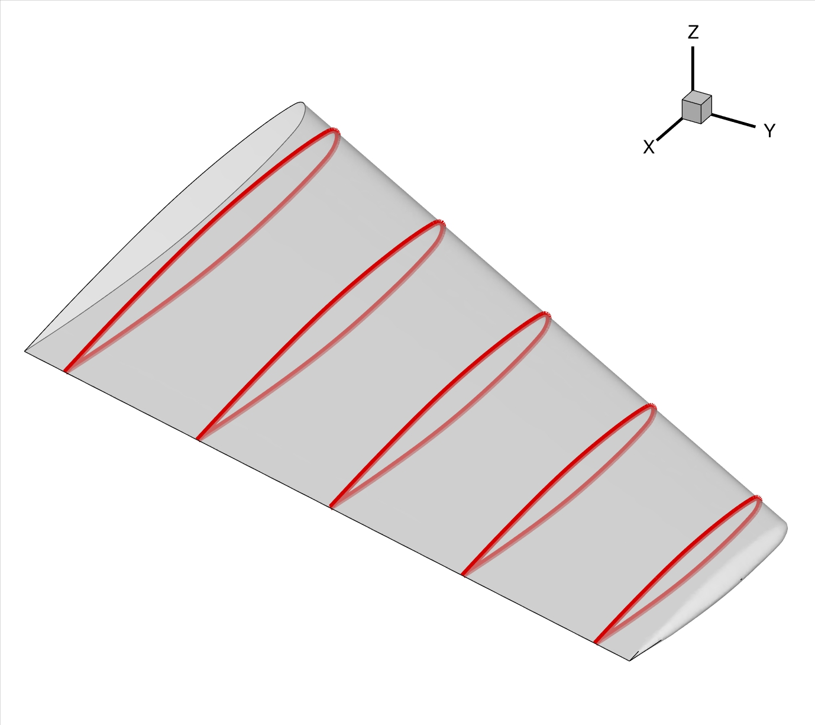
ONERA M6 Shape Optimization (Euler and RANS)
Define and run the physical problem.
Evaluate geometry (thickness, AoA, etc).
Define 3D design variables.
Create the FFD box (.su2 file).
FFD design variables preprocessing.
Define the optimization problem
Objective function.
Constraints (flow and geometry).
Design variables based on FFD box.
Checks before the optimization (optional).
Compute C_{D}, and C_{L} gradients.
Compute geometric gradients.
Final checks (optional).
Restart files are available.
The grid contains the FFD information.
The stop criteria is reasonable.
The proposed optimization problem makes sense (scaling).
Run the optimization.
Analyze the solution.
Folder structure and history_project file.
Restart capability.

Slide 31
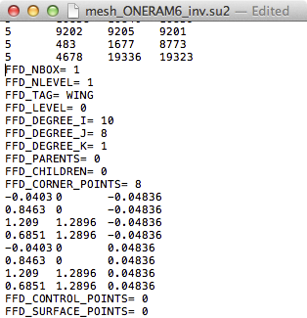
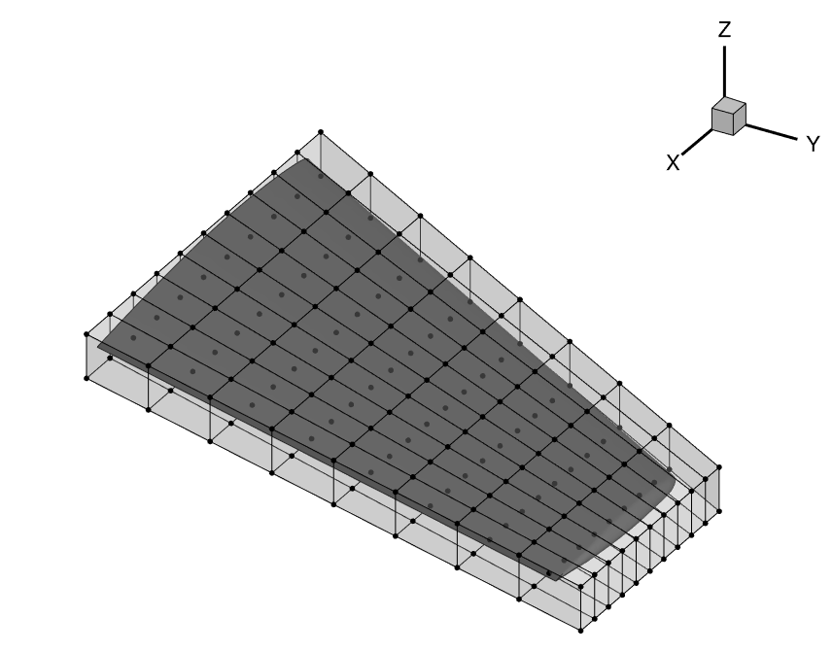
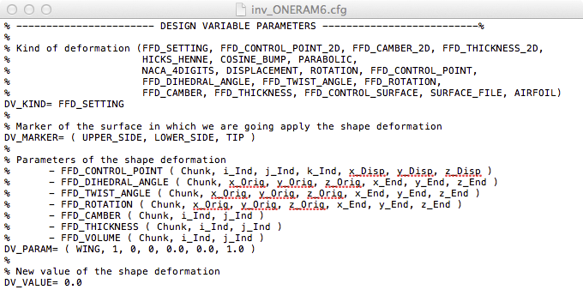
ONERA M6 Shape Optimization (Euler and RANS)
Define and run the physical problem.
Evaluate geometry (thickness, AoA, etc).
Define 3D design variables.
Create the FFD box (.su2 file).
FFD design variables preprocessing.
Define the optimization problem
Objective function.
Constraints (flow and geometry).
Design variables based on FFD box.
Checks before the optimization (optional).
Compute C_{D}, and C_{L} gradients.
Compute geometric gradients.
Final checks (optional).
Restart files are available.
The grid contains the FFD information.
The stop criteria is reasonable.
The proposed optimization problem makes sense (scaling).
Run the optimization.
Analyze the solution.
Folder structure and history_project file.
Restart capability.

Slide 32
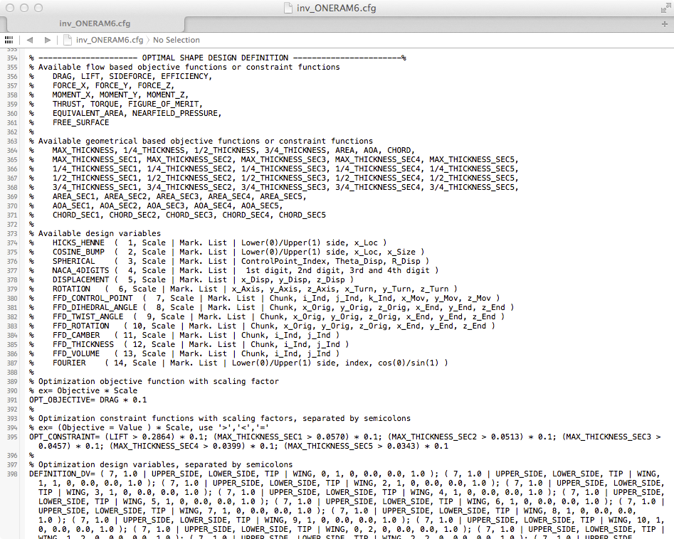
ONERA M6 Shape Optimization (Euler and RANS)
Define and run the physical problem.
Evaluate geometry (thickness, AoA, etc).
Define 3D design variables.
Create the FFD box (.su2 file).
FFD design variables preprocessing.
Define the optimization problem
Objective function.
Constraints (flow and geometry).
Design variables based on FFD box.
Checks before the optimization (optional).
Compute C_{D}, and C_{L} gradients.
Compute geometric gradients.
Final checks (optional).
Restart files are available.
The grid contains the FFD information.
The stop criteria is reasonable.
The proposed optimization problem makes sense (scaling).
Run the optimization.
Analyze the solution.
Folder structure and history_project file.
Restart capability.
- Do not forget to check the name of the mesh.
- There are scripts to generate the list of design variables.

Slide 33
Building SU² Tips for Hassle-Free Builds
$ ./set_ffd_design_var.py -i 30 -j 1 -b MAIN_BOX -m airfoil -s 1.0
Tip: Use the set_ffd_design_var.py script in order to easily define your set of FFD design variables in the configuration file.

Slide 34
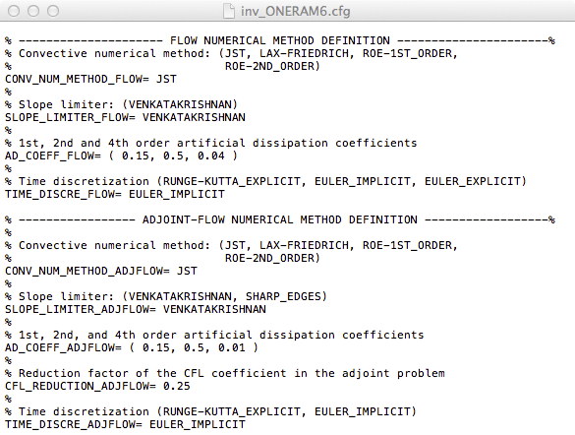
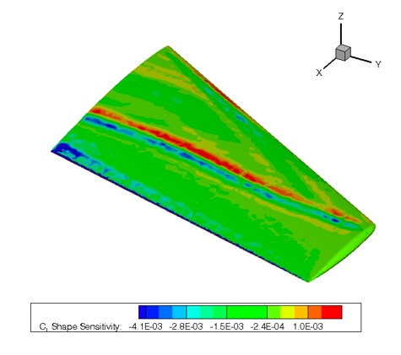
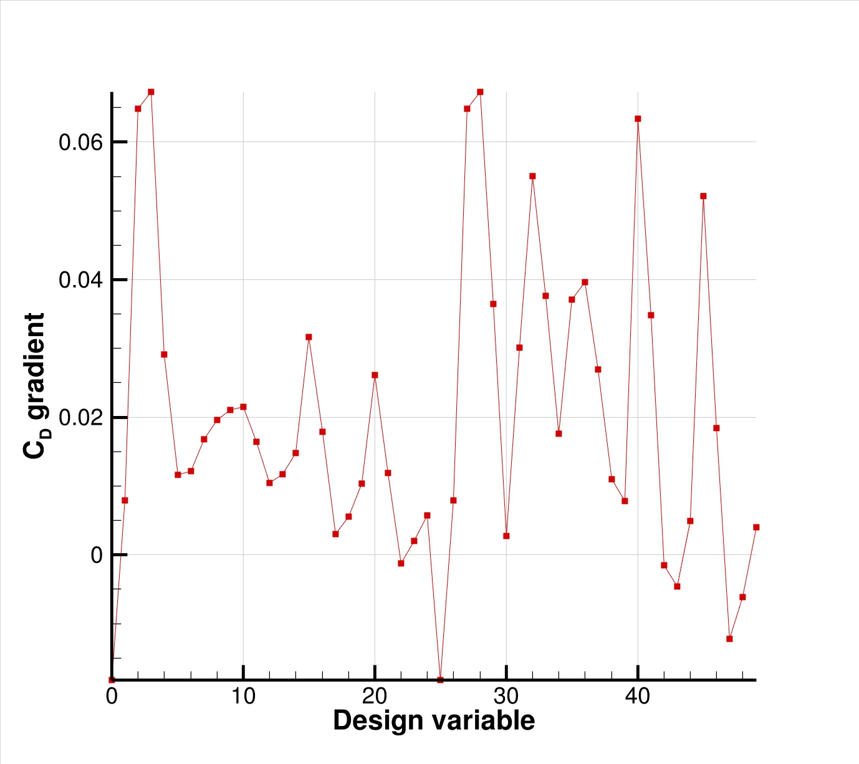
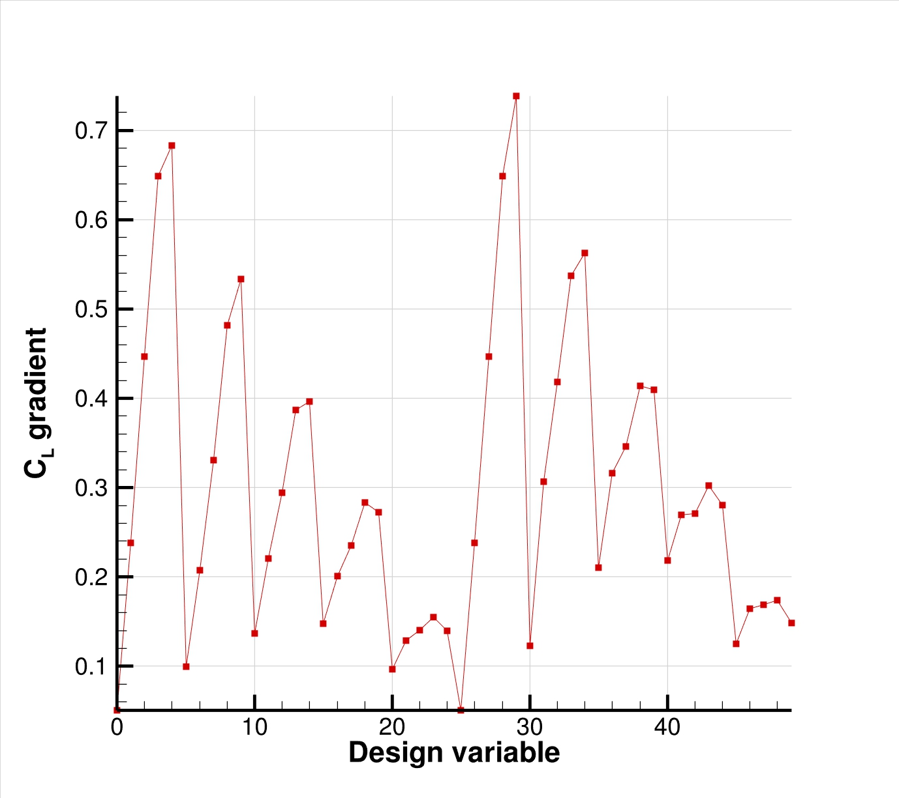
ONERA M6 Shape Optimization (Euler and RANS)
Define and run the physical problem.
Evaluate geometry (thickness, AoA, etc).
Define 3D design variables.
Create the FFD box (.su2 file).
FFD design variables preprocessing.
Define the optimization problem
Objective function.
Constraints (flow and geometry).
Design variables based on FFD box.
Checks before the optimization (optional).
Compute C_{D}, and C_{L} gradients.
Compute geometric gradients.
Final checks (optional).
Restart files are available.
The grid contains the FFD information.
The stop criteria is reasonable.
The proposed optimization problem makes sense (scaling).
Run the optimization.
Analyze the solution.
Folder structure and history_project file.
Restart capability.

Slide 35
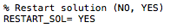
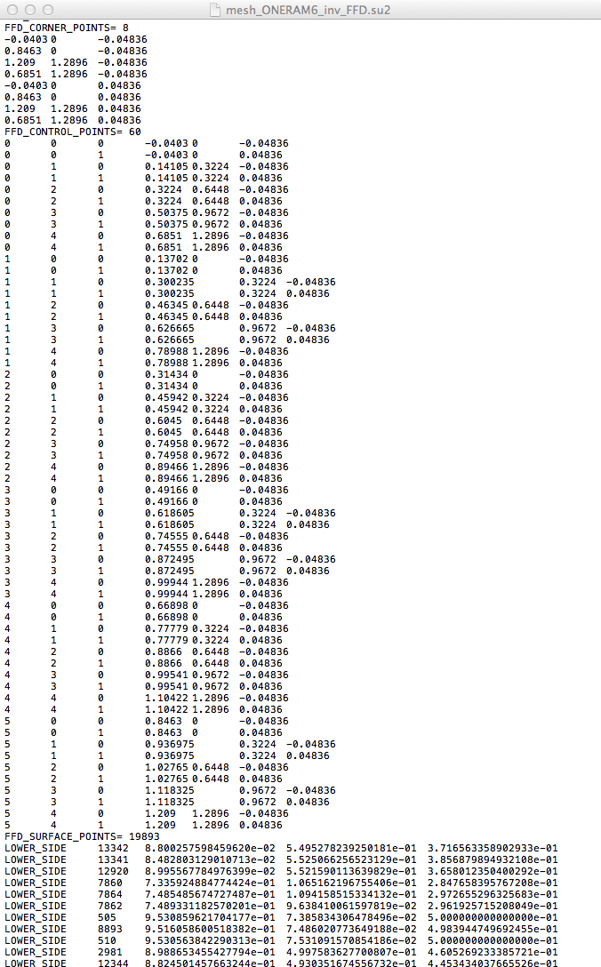
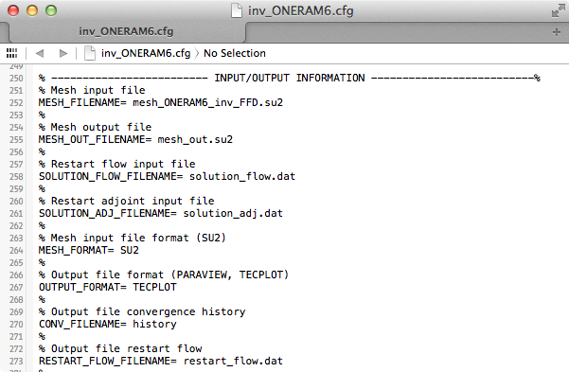
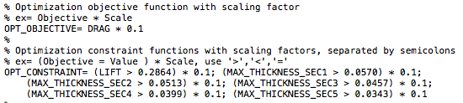
ONERA M6 Shape Optimization (Euler and RANS)
Define and run the physical problem.
Evaluate geometry (thickness, AoA, etc).
Define 3D design variables.
Create the FFD box (.su2 file).
FFD design variables preprocessing.
Define the optimization problem
Objective function.
Constraints (flow and geometry).
Design variables based on FFD box.
Checks before the optimization (optional).
Compute C_{D}, and C_{L} gradients.
Compute geometric gradients.
Final checks (optional).
Restart files are available.
The grid contains the FFD information.
The stop criteria is reasonable.
The proposed optimization problem makes sense (scaling).
Run the optimization.
Analyze the solution.
Folder structure and history_project file.
Restart capability.

Slide 36

ONERA M6 Shape Optimization (Euler and RANS)
Define and run the physical problem.
Evaluate geometry (thickness, AoA, etc).
Define 3D design variables.
Create the FFD box (.su2 file).
FFD design variables preprocessing.
Define the optimization problem
Objective function.
Constraints (flow and geometry).
Design variables based on FFD box.
Checks before the optimization (optional).
Compute C_{D}, and C_{L} gradients.
Compute geometric gradients.
Final checks (optional).
Restart files are available.
The grid contains the FFD information.
The stop criteria is reasonable.
The proposed optimization problem makes sense (scaling).
Run the optimization.
Analyze the solution.
Folder structure and history_project file.
Restart capability.

Slide 37
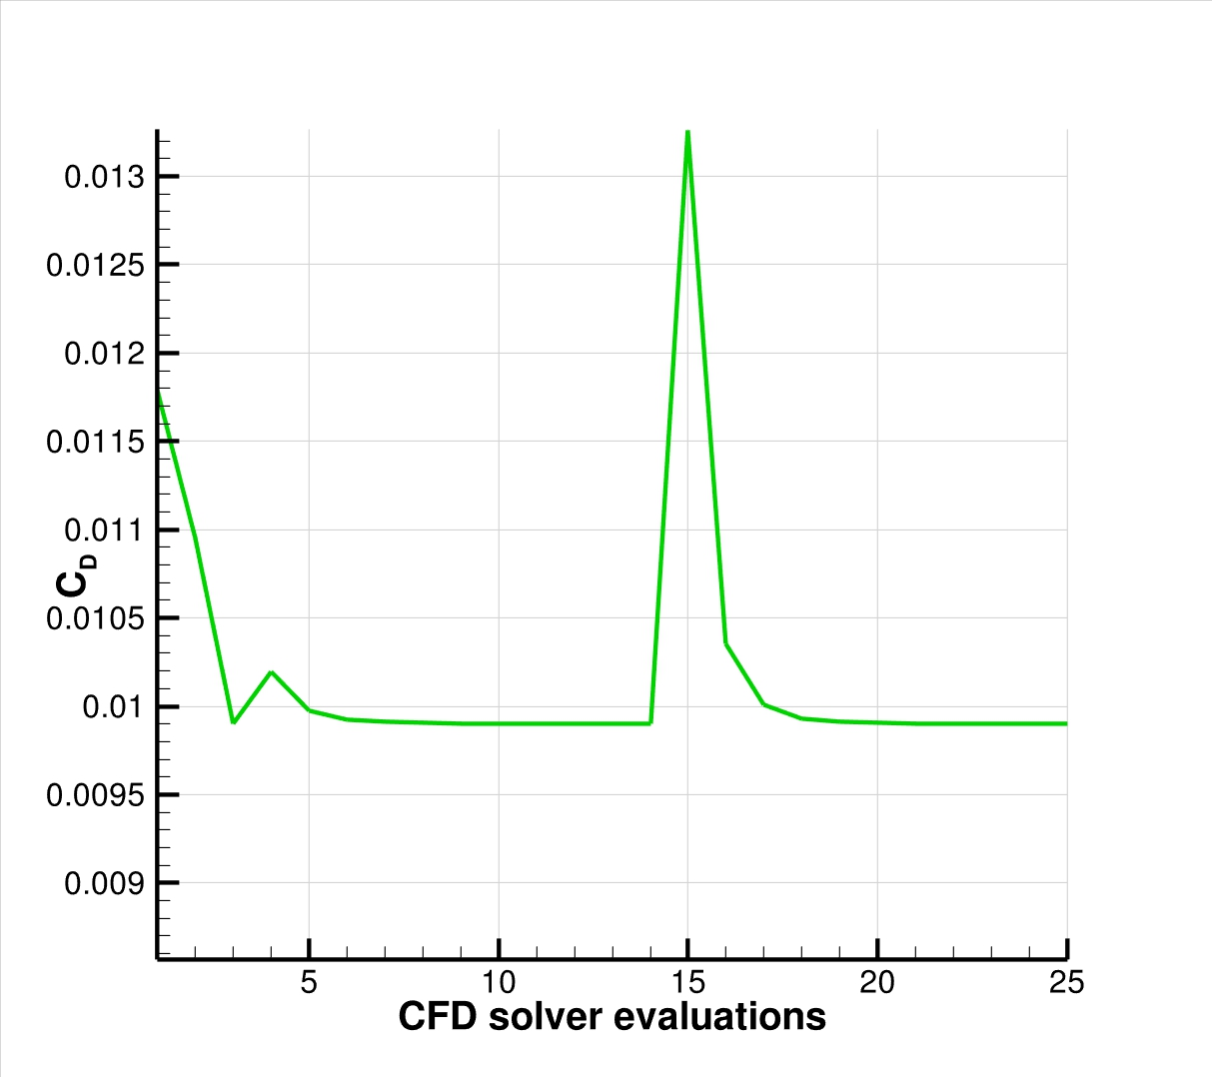
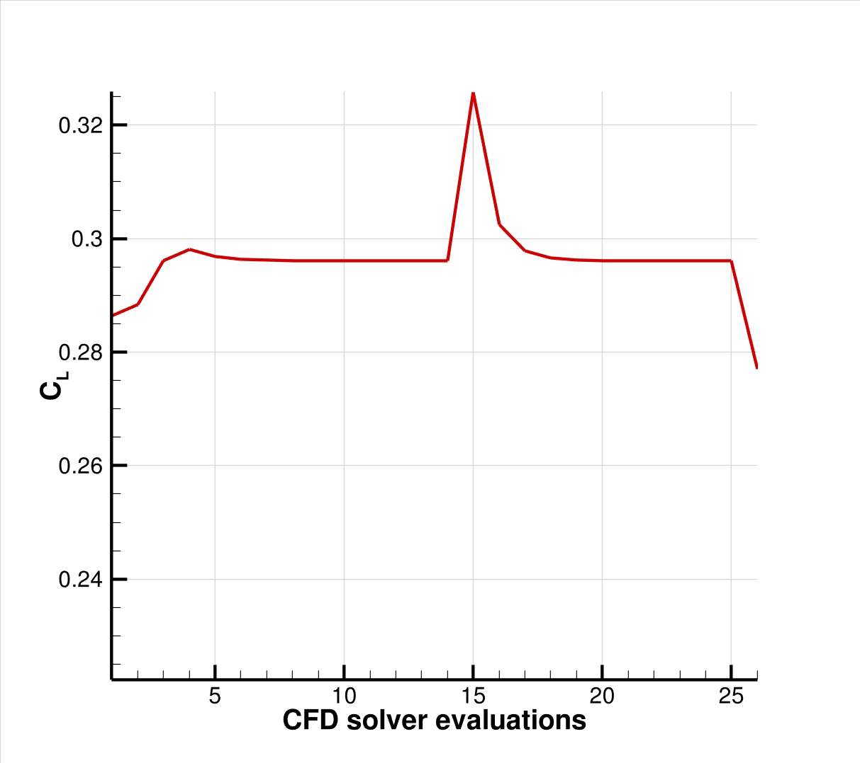
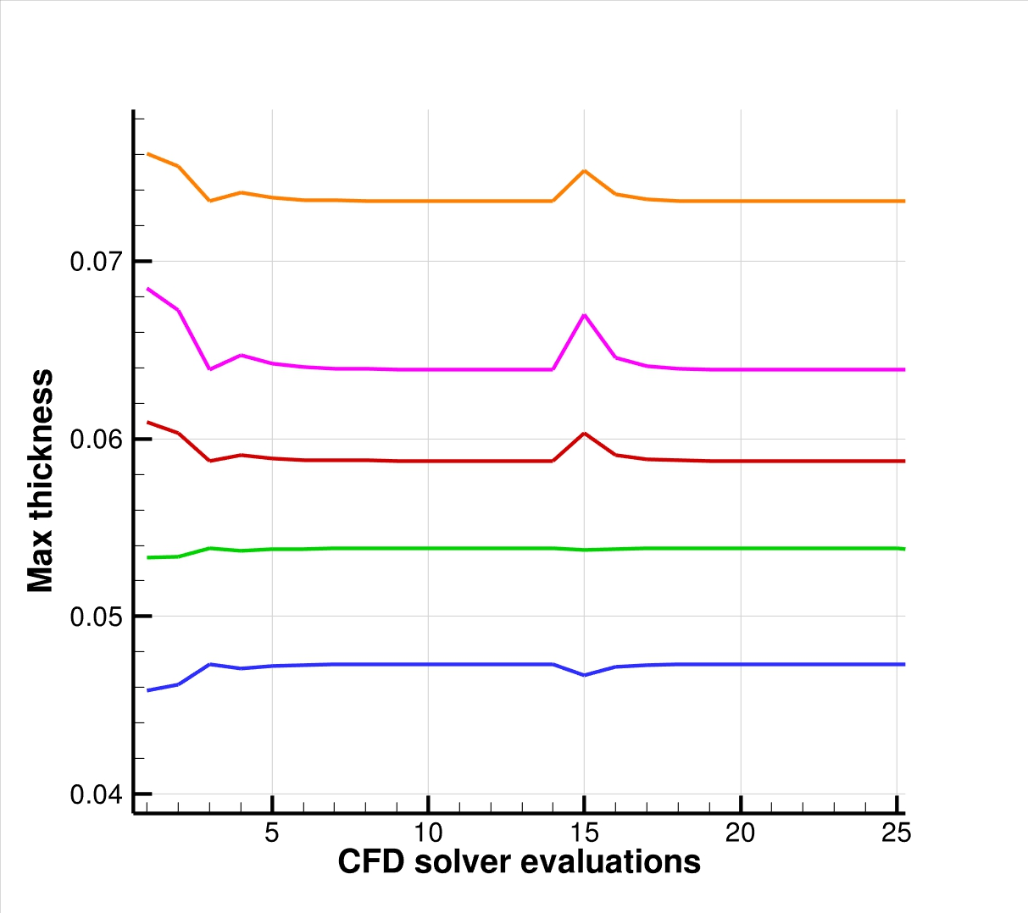
ONERA M6 Shape Optimization (Euler and RANS)
Define and run the physical problem.
Evaluate geometry (thickness, AoA, etc).
Define 3D design variables.
Create the FFD box (.su2 file).
FFD design variables preprocessing.
Define the optimization problem
Objective function.
Constraints (flow and geometry).
Design variables based on FFD box.
Checks before the optimization (optional).
Compute C_{D}, and C_{L} gradients.
Compute geometric gradients.
Final checks (optional).
Restart files are available.
The grid contains the FFD information.
The stop criteria is reasonable.
The proposed optimization problem makes sense (scaling).
Run the optimization.
Analyze the solution.
Folder structure and history_project file.
Restart capability.
RANS optimization (49 design variables)
Baseline C_{D}= 0.0197, C_{L} = 0.2684
Final C_{D}= 0.0179, C_{L} = 0.2731
Euler optimization (175 design variables)
Baseline C_{D}= 0.0118, C_{L} = 0.2864
Final C_{D}= 0.0099, C_{L} = 0.2960

Slide 38
Thanks a lot for your attention!
Questions & Answers
More details in http://su2.stanford.edu/

